Slide 1


Soheyla Moghadam
https://github.com/SoheylaMoghadam
22/08/2023

Slide 2

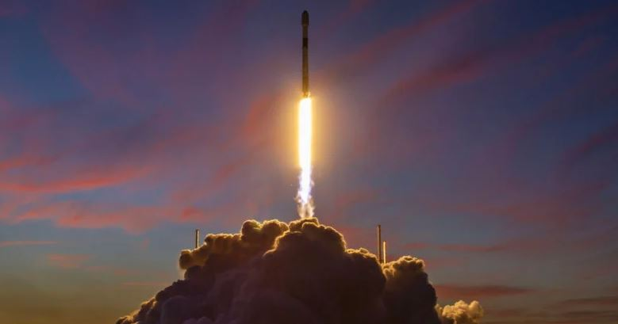
Outline
Executive Summary
Introduction
Methodology
Results
Conclusion
Appendix

Slide 3
Executive Summary
Summary of methodologies
Summary of all results
Data collection
Data wrangling
EDA with data visualization & SQL
Building an interactive map with Folium
Building a Dashboard with Plotly Dash
Predictive analysis (Classification)
EDA results
Interactive analytics
Predictive analysis

Slide 4
Introduction
Project background and context
SpaceX advertises Falcon 9 rocket launches on its website, with a cost of 62 million vs 165 million USD, because SpaceX can reuse the first stage.
Problems you want to find answers
This project will Predict Successful Landing of SpaceX Falcon 9 First Stage by using Machine Learning Models.

Slide 5

Section 1

Slide 6
Methodology
Executive Summary
Data collection methodology:
Combined dataset from the SpaceX public API and the SpaceX Wikipedia page
Perform data wrangling
Cleaning data, handling missing values and encoding data for using machine learning models
Perform exploratory data analysis (EDA) using visualization and SQL
Perform interactive visual analytics using Folium and Plotly Dash
Perform predictive analysis using classification models
Tuned models using GridSearchCV and find the best classifier model

Slide 7
Data Collection
Data collection involves gathering relevant data API requests from Space X public API and web scraping data from a table in Space X’s Wikipedia entry.
The datasets of SpaceX API include information such as rocket launches, mission details, payload information, and more.
The data columns of the Wikipedia webscraped dataset involve Flight No., Launch site, Payload, Payload Mass, Orbit, Customer, Launch outcome, Version, Booster, Booster landing, Date, and Time.
SpaceX API
Returns SpaceX data in Json
Normalize data (.csv)
Prepared data for consolidation and wrangling
Get HTML Response of Wikipedia
Extract data by beautiful soup
Normalize data (.csv)

Slide 8
Data Collection – SpaceX API
Steps in the process of collecting SpaceX launch data using the SpaceX API:
GitHub URL:
https://github.com/SoheylaMoghadam/Applied-Data-Science-Capstone/blob/main/jupyter-labs-spacex-data-collection-api.ipynb
Request API and parse the SpaceX launch data
convert .json() to
a Pandas DataFrame using .json_normalize()
Filter the DataFrame to only include Falcon 9 launches
Dealing with Missing Values

Slide 9
Data Collection - Scraping
Steps in the process of Web scrapping from Wikipedia:
GitHub URL:
https://github.com/SoheylaMoghadam/Applied-Data-Science-Capstone/blob/main/jupyter-labs-webscraping.ipynb
Request the Falcon9
Launch Wiki page from its URL
Extract all column/variable names from the HTML table header
Create a DataFrame by parsing the launch HTML tables

Slide 10
Data Wrangling
Steps of data wrangling:
Identify and calculate the missing values
Calculate the number and occurrence of mission outcome per orbit type
Determine the number of launches on each site
Determine the number and occurrence of each orbit
Create a landing outcome label from Outcome column
GitHub URL:
https://github.com/SoheylaMoghadam/Applied-Data-Science-Capstone/blob/main/labs-jupyter-spacex-data_wrangling_jupyterlite.jupyterlite.ipynb

Slide 11
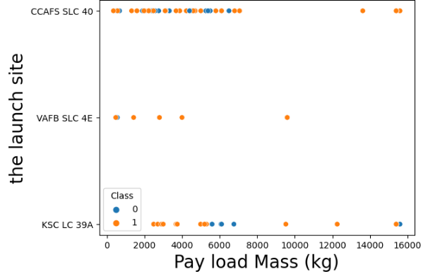
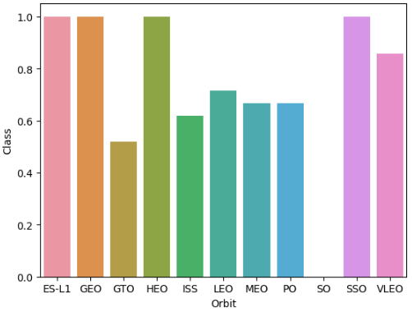
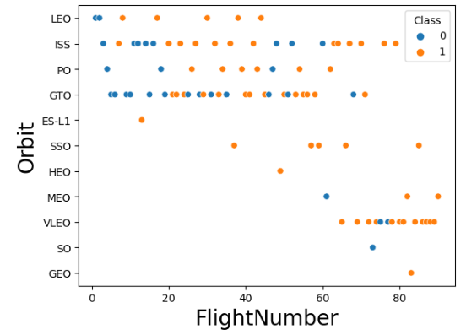
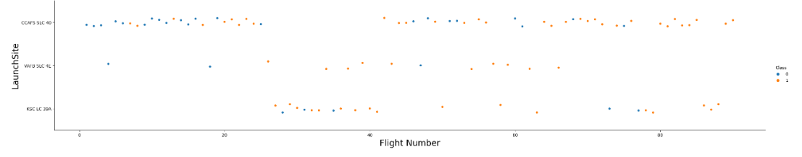
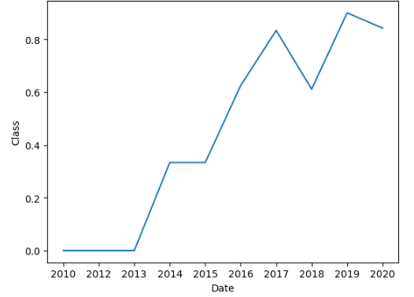
EDA with Data Visualization
Exploratory Data Analysis performed on variables Flight Number, Payload Mass, Launch Site, Orbit, Class and Year.
https://github.com/SoheylaMoghadam/Applied-Data-Science-Capstone/blob/main/jupyter-labs-eda-dataviz.ipynb

Slide 12
EDA with SQL
Display the unique launch site names in the space mission.
Show 5 records where launch sites start with the string 'KSC'.
Display the total payload mass carried by boosters launched by NASA (CRS).
Show the average payload mass carried by booster version F9 v1.1.
List the date when successful landing outcomes were achieved on a drone ship.
List the names of boosters that had success on a ground pad and had a payload mass greater than 4000 but less than 6000.
List the total number of successful and failed mission outcomes.
List the names of booster versions that carried the maximum payload mass.
List the records displaying the month names, successful landing outcomes on ground pad booster versions, and launch site for the months in the year 2017.
Rank the count of successful landing outcomes between the dates 2010-06-04 and 2017-03-20 in descending order.
https://github.com/SoheylaMoghadam/Applied-Data-Science-Capstone/blob/main/jupyter-labs-eda-sql-coursera_sqllite.ipynb

Slide 13
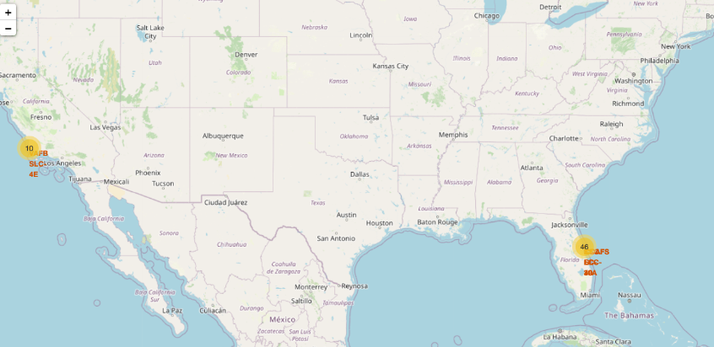
Build an Interactive Map with Folium
https://github.com/SoheylaMoghadam/Applied-Data-Science-Capstone/blob/main/lab_jupyter_launch_site_location.ipynb

Slide 14
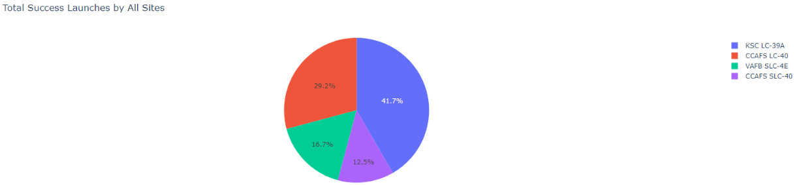
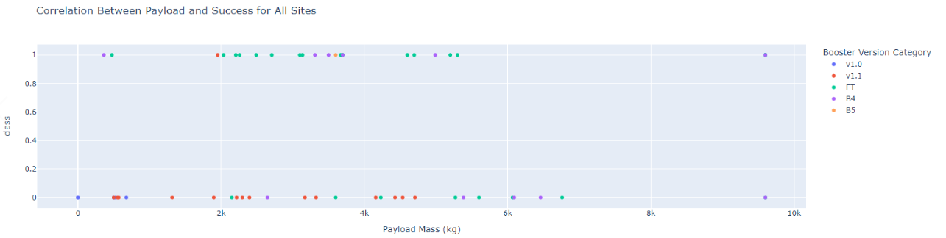
Build a Dashboard with Plotly Dash
https://github.com/SoheylaMoghadam/Applied-Data-Science-Capstone/blob/main/spacex_dash_app.py

Slide 15
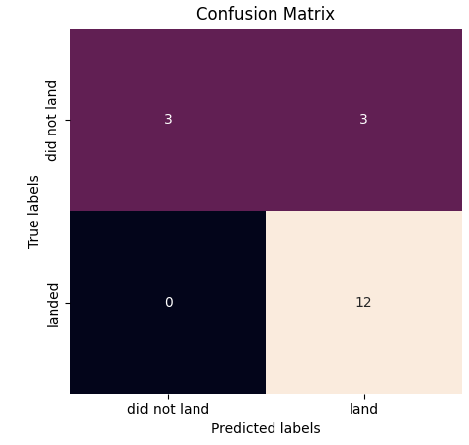
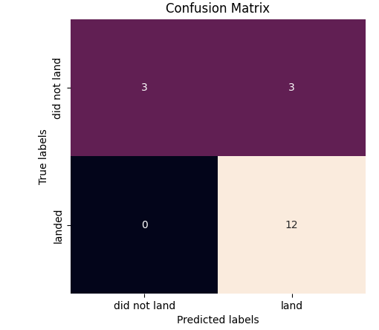
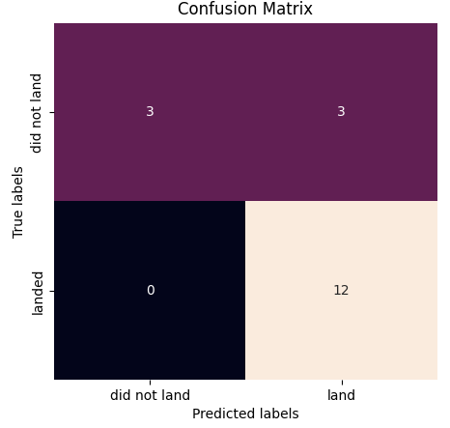
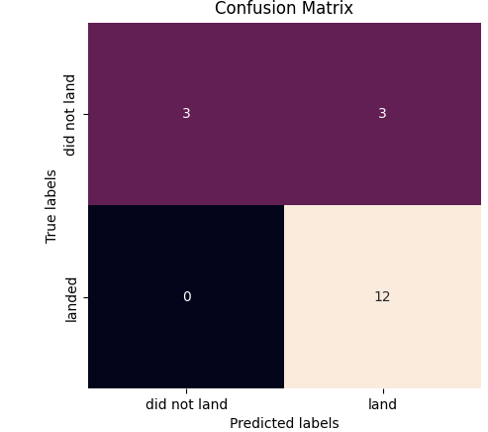
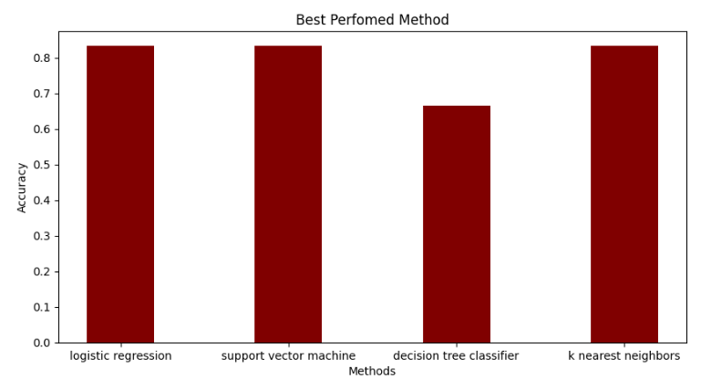
Predictive Analysis (Classification)
The models of SVM, KNN, and Logistic Regression demonstrated the highest level of accuracy, achieving a rate of 83.3%.

Slide 16
Results
The SVM, KNN, and Logistic Regression models demonstrate superior prediction accuracy on this dataset.
Lighter weighted payloads exhibit superior performance compared to heavier payloads.
The success rates of SpaceX launches are expected to improve over time, with a direct correlation to the number of years they have been perfecting their launches.
Among all the sites, KSC LC 39A has witnessed the highest number of successful launches.
Orbits such as GEO, HEO, SSO, and ES L1 exhibit the highest success rates.

Slide 17

Section 2

Slide 18
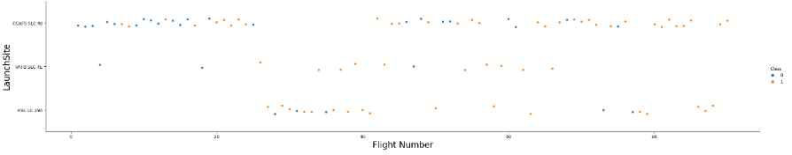
Flight Number vs. Launch Site
Launches originating from CCAFS SLC 40 exceed the number of launches from alternative sites by a substantial margin

Slide 19
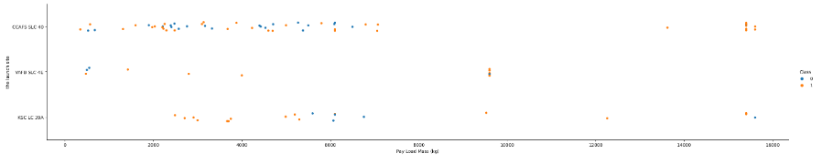
Payload vs. Launch Site
CCAFS SLC 40 has witnessed the launch of a significant number of payloads that possess comparatively lower masses.

Slide 20
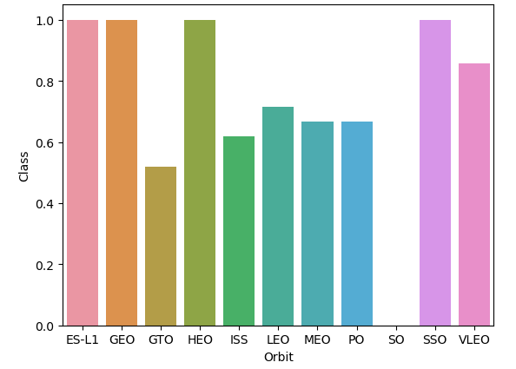
Success Rate vs. Orbit Type
ES-L1, GEO, HEO, and SSO orbit types demonstrate exceptionally high success rates.

Slide 21
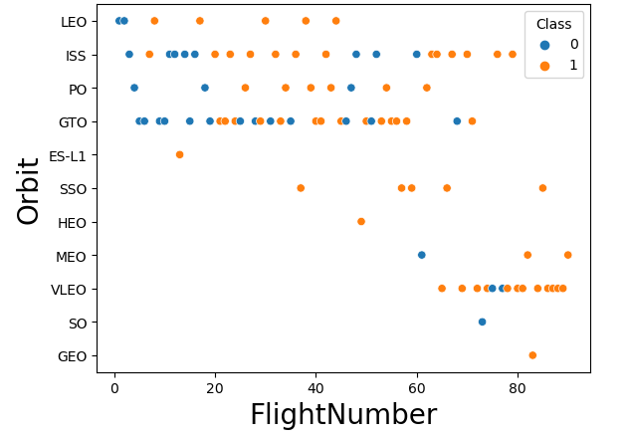
Flight Number vs. Orbit Type

Slide 22
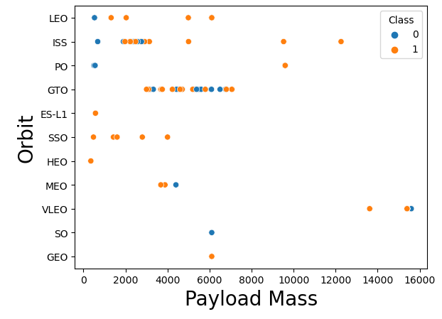
Payload vs. Orbit Type
The orbit of the International Space Station (ISS) not only supports a wide range of payload sizes but also demonstrates a remarkable success rate.

Slide 23
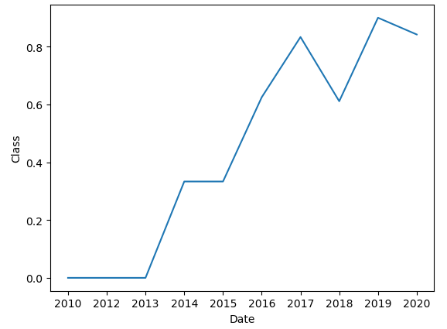
Launch Success Yearly Trend
The success rate of launches began to rise in 2013 and continued to increase steadily until 2020.

Slide 24
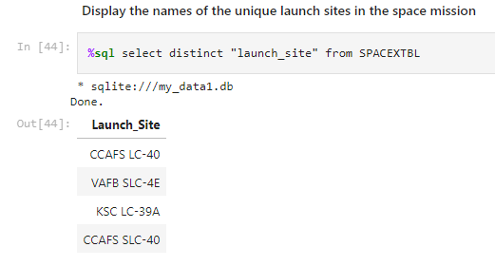
All Launch Site Names

Slide 25
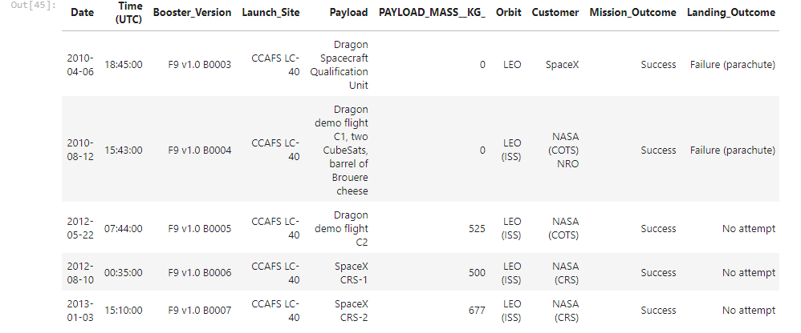
Launch Site Names Begin with 'CCA'

Slide 26
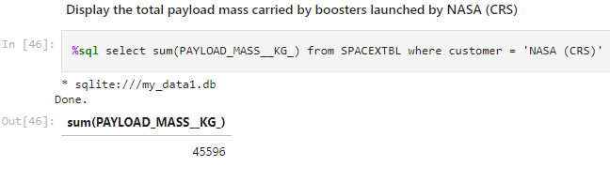
Total Payload Mass

Slide 27
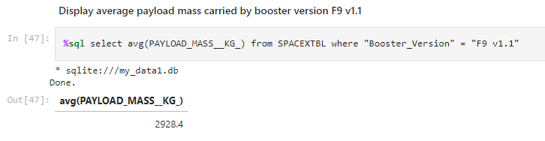
Average Payload Mass by F9 v1.1

Slide 28
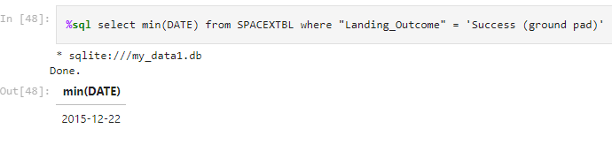
First Successful Ground Landing Date
The dates of the first successful landing outcome on ground pad

Slide 29
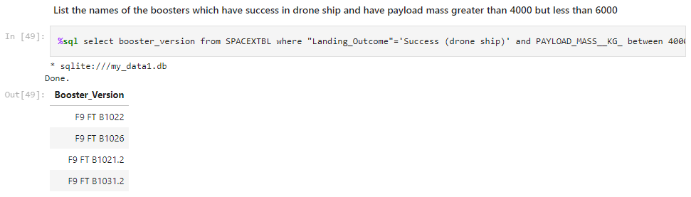
Successful Drone Ship Landing with Payload between 4000 and 6000

Slide 30
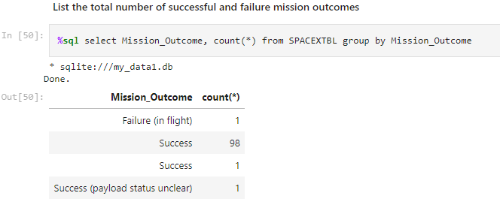
Total Number of Successful and Failure Mission Outcomes

Slide 31
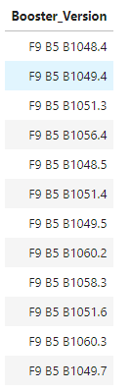
Boosters Carried Maximum Payload
The given list shows the names of the booster versions that have achieved the highest payload masses

Slide 32
2015 Launch Records
%sql select substr(Date, 4, 2) as month, "Landing_Outcome", Booster_Version , Launch_Site from SPACEXTBL where "Landing_Outcome" = 'Failure (drone ship)' and substr(Date,7,4)='2015'
This query returns the Month, Landing Outcome, Booster Version, Payload Mass (kg), and Launch site of 2015 launches where stage 1 failed to land on a drone ship.

Slide 33
Rank Landing Outcomes Between 2010-06-04 and 2017-03-20
%sql SELECT "LANDING__OUTCOME", COUNT(*) AS COUNT_LAUNCHES FROM SPACEXTBL WHERE DATE BETWEEN '2010-06-04' AND '2017-03-20' GROUP BY LANDING__OUTCOME ORDER BY COUNT_LAUNCHES DESC;
This query returns a list of successful landings and between 2010-06-04 and 2017-03-20 inclusively.

Slide 34

Section 3

Slide 35
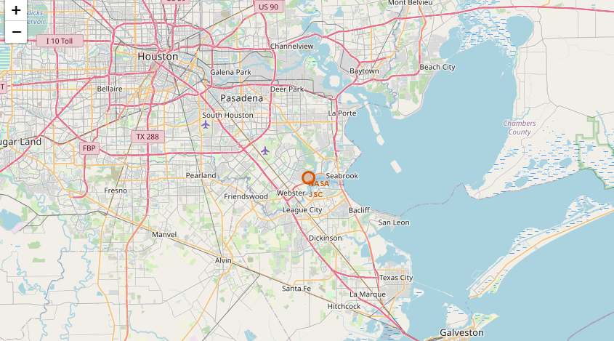
Folium Map Screenshot 1

Slide 36
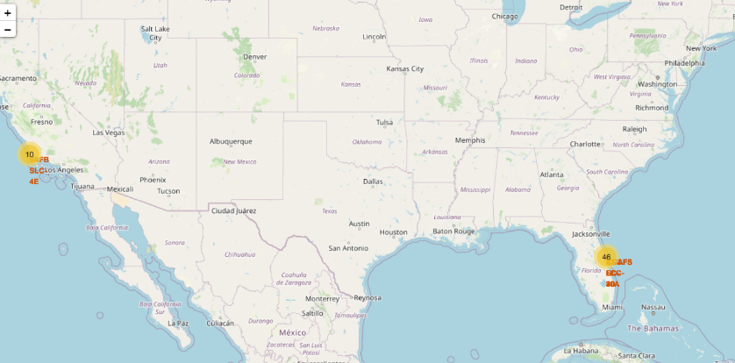
Folium Map Screenshot 2

Slide 37
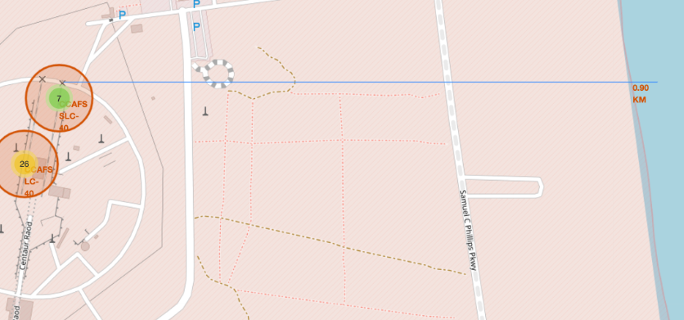

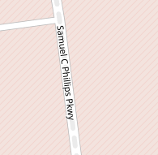

Folium Map Screenshot 3

Slide 38

Section 4

Slide 39
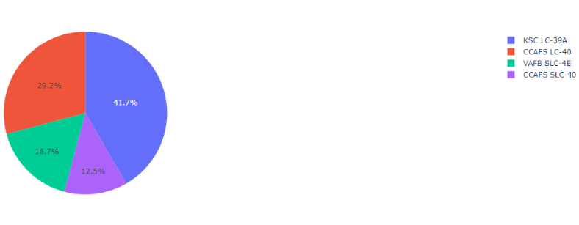
Total success launches by all sites
SpaceX Launch Records Dashboard

Slide 40
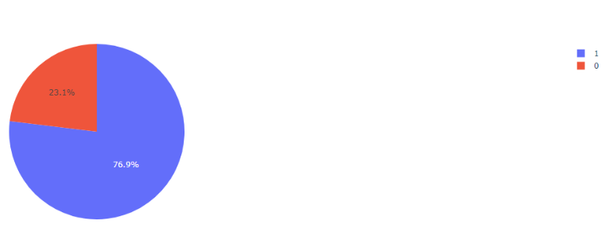
SpaceX Launch Records Dashboard
Total success launches by site: KSC LC-39A

Slide 41
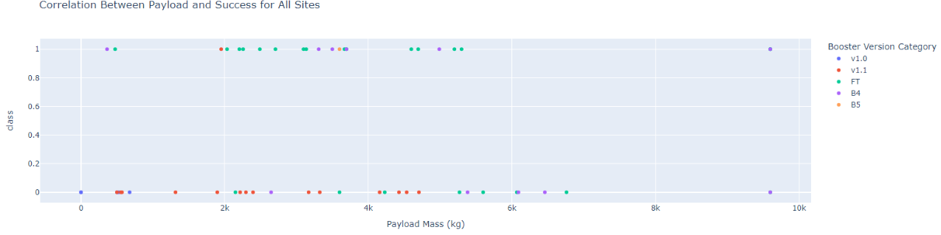
SpaceX Launch Records Dashboard
The given scatter plot shows the correlation between payload and launch success

Slide 42

Section 5

Slide 43
Classification Accuracy
SVM, KNN and Logistic Regression have the highest classification accuracy

Slide 44
Confusion Matrix

Slide 45
Conclusions
The SVM, KNN, and Logistic Regression models exhibit better prediction accuracy compared to Decision Tree model on this dataset.
Payloads with lower weights exhibit better performance compared to heavier payloads.
The success rates of SpaceX launches increase proportionally with the number of years dedicated to perfecting the launches.
Among all the launch sites, KSC LC 39A stands out with the highest number of successful launches.

Slide 46


